Slide 1
Welcome to group 5 presentation
Groups members:
Trương Tấn Tài
Lê Phương Thủy
Hoàng Anh Trung
Phạm Minh Đăng
Võ Hoàng Hiển

Slide 2
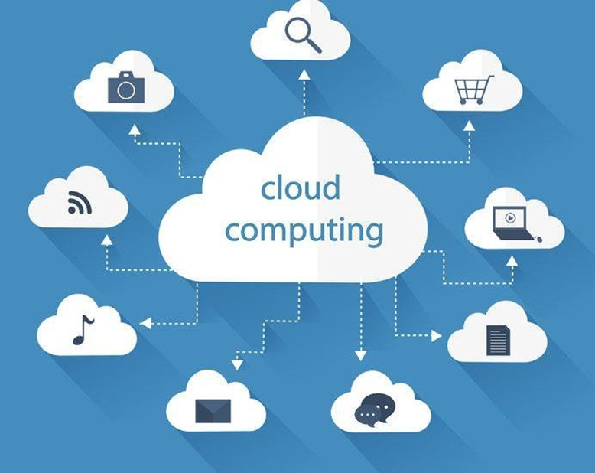
P1. ANALYZE THE EVOLUTION AND FUNDAMENTAL CONCEPTS OF CLOUD COMPUTING
1.1 WHAT IS CLOUD COMPUTING
Cloud computing is a technology that brings your entire computer infrastructure into both hardware and software applications online. It uses the internet, a remote central server to maintain data & applications

Slide 3
1.2 HOW IS WORK OF CLOUD COMPUTING
In essence, technology is a geographical change in the location of our data from a personal computer to a centralized server or 'cloud'. Typically, cloud services charge their customers on a usage basis.
Therefore, it is also known as Software as a Service (SaaS). It aims to provide infrastructure and online resources to serve its customers; Dynamic abstraction and resource sharing.

Slide 4
1.3 THE HISTORY OF CLOUD COMPUTING
1. The Idea Phase - This phase incepted in the early 1960s with the emergence of utility and grid computing and lasted till pre-internet bubble era. Joseph Carl Robnett Licklider was the founder of cloud computing.
2. The Pre-cloud Phase - The pre-cloud phase originated in 1999 and extended to 2006. In this phase the internet as the mechanism to provide Application as Service.
3. The Cloud Phase - The much talked about real cloud phase started in the year 2007 when the classification of IaaS, PaaS, and SaaS got formalized. The history of cloud computing has witnessed some very interesting breakthroughs launched by some of the leading computer/web organizations of the world.

Slide 5
1.4 TYPE OF CLOUD
1. Public Cloud - When a cloud is available to the general public on a pay-per-use basis, that cloud is called a ‘Public Cloud’.
2. Private Cloud - The internal data centers of business organizations which are not made available to the general public are termed as a private cloud
3. Hybrid Cloud - A combination of private and public cloud is called a hybrid cloud. Companies use their own infrastructure for normal usage and hire the cloud at events of heavy network traffic or high data load.

Slide 6
1.5 ADVANTAGE AND BENEFIT OF CLOUD COMPUTING BRING PEOPLE
1.Cost savings
2.Instant access anytime anywhere
3.The ability to transform endlessly
4.Adaptability
5.Sustainable cooperation, not disturbance
6.Data security
7.Stand out with the modern trend

Slide 7
P2. Design an appropriate architectural Cloud Computing framework for a given scenario.
1. definition
The dynamic scalability architecture is an architectural model based on a system of predefined scaling conditions that trigger the dynamic allocation of IT resources from resource pools. Dynamic allocation enables variable utilization as dictated by usage demand fluctuations, since unnecessary IT resources are efficiently reclaimed without requiring manual interaction.
The following types of dynamic scaling are commonly used:
• Dynamic Horizontal Scaling per requirements and permissions.
• Dynamic Vertical Scaling
• Dynamic Relocation

Slide 8
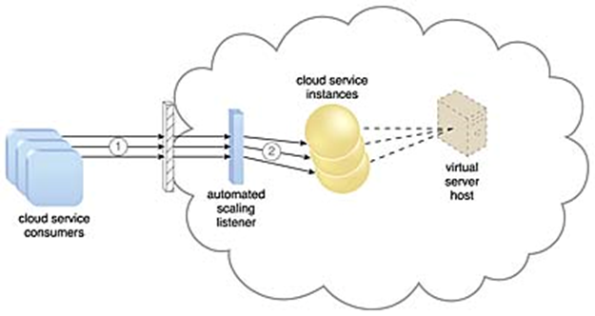
2. Chosen architectural Cloud Computing framework
•Cloud service consumers are sending requests to a cloud service
•The automated scaling listener monitors the cloud service to determine if predefined capacity thresholds are being exceeded

Slide 9
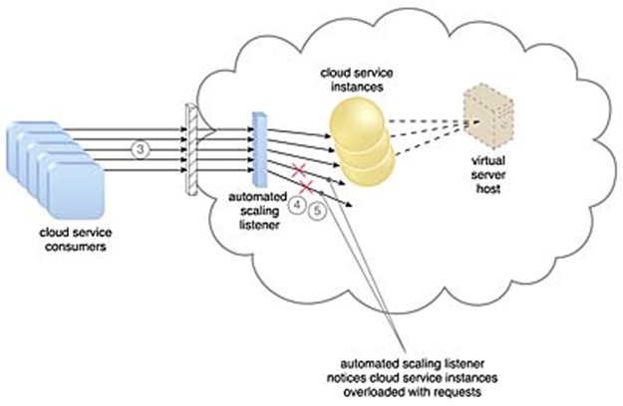
•The number of requests coming from cloud service consumers increases.
•The workload exceeds the performance thresholds. The automated scaling listener determines the next course of action based on a predefined scaling policy.
•If the cloud service implementation is deemed eligible for additional scaling, the automated scaling listener initiates the scaling process

Slide 10
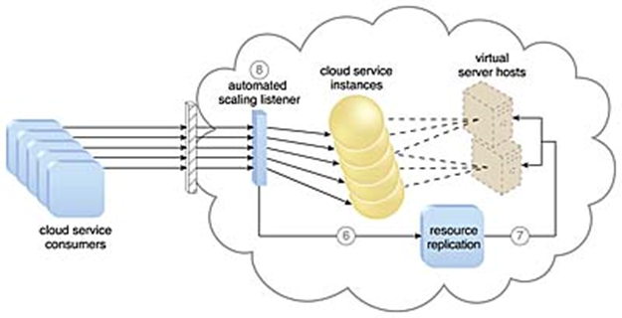
•The automated scaling listener sends a signal to the resource replication mechanism , which creates more instances of the cloud service .
•Now that the increased workload has been accommodated, the automated scaling listener resumes monitoring and detracting and adding IT resources, as required .

Slide 11
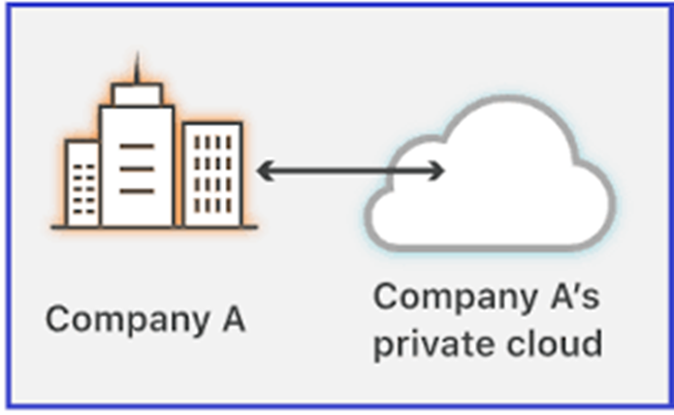
P3 Define an appropriate deployment model for a given scenario.
1. definition for chosen model
Private cloud infrastructure is dedicated to a single organization or enterprise. The software and applications in a private cloud are usually proprietary platforms tailored to meet the needs of the business.

Slide 12
2. Explanation for chosen model
The main purposes of applying private cloud to this project is that users don't share resources. Because of its proprietary nature, a private cloud computing model is best for businesses with dynamic or unpredictable computing needs that require direct control over their environments, typically to meet security, business governance or regulatory compliance requirements.

Slide 13
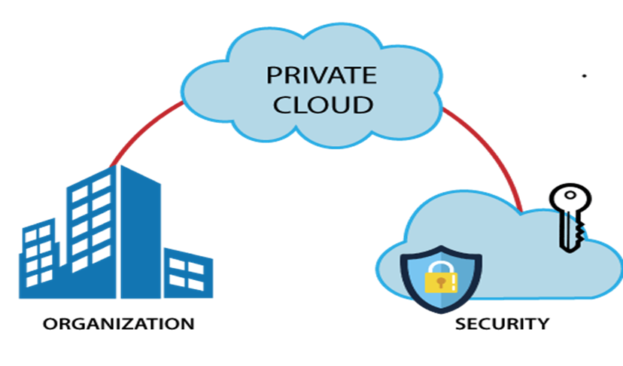
Three main characteristics: 1. Increased security of an isolated network.

Slide 14
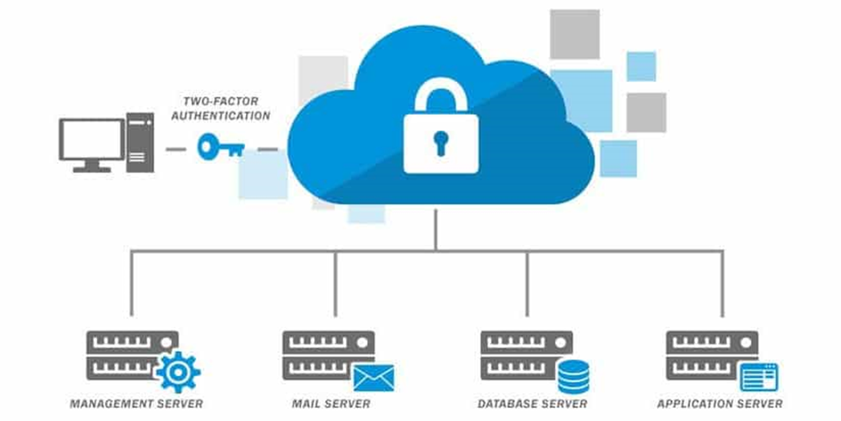
2. Increased performance due to resources being solely dedicated to one organization.

Slide 15
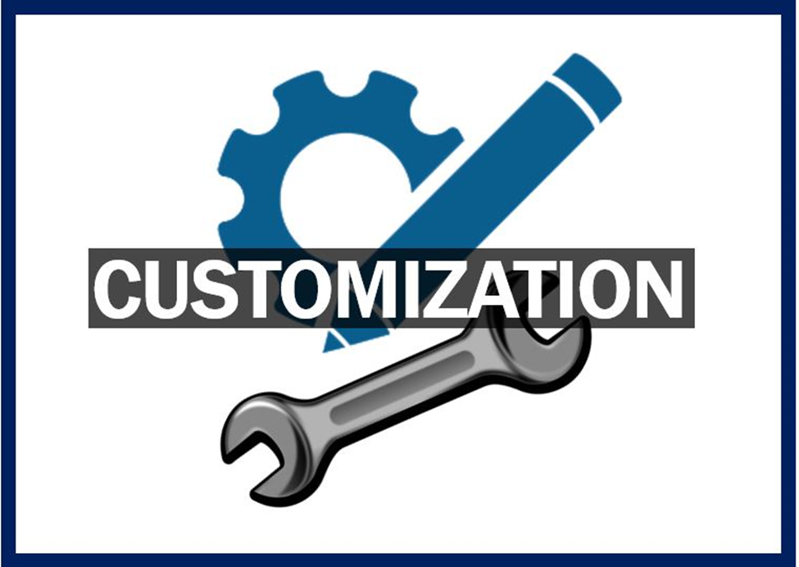
3. Increased capability for customization.

Slide 16
P4 Compare the service models for choosing an adequate model for a given scenario.
 | IaaS | PaaS | SaaS
Advantage | Minimize Costs Enhanced Scalability Simple Deployment | Minimal Development Time Multiple Programming Language Support Enhanced Collaboration | Affordable Anywhere Accessibility Ready to Use
Disadvantage | Security. Legacy systems operating in the cloud. Internal resources and training. Multi-tenant security | Data security Integrations. Vendor lock-in Customization of legacy systems. Runtime issues. | Vendor lock-in Lack of integration support Data security Lack of control
Conclusion | Each cloud model has its own set of features and functions, and it's critical that your company understands the differences. There is a cloud service for you whether you need cloud-based software for storage, a smooth platform for creating customized applications, or complete control over your entire infrastructure without having to physically maintain it. Migrating to the cloud, regardless of which option you choose, is the future of business and technology.

